Slide 1
Advisor Back to School Meeting
August 27 and 28, 2024

Slide 2
Welcome!
Mute your microphone
Turn on your camera ☺
Stay adaptable and flexible
Ask lots of questions! (use the chat feature)

Slide 3
Agenda
SkillsUSA Basics
Membership Benefits and Resources
Your Role as an Advisor
Membership Information and Registration
General Event Information and Registration
Invoicing, Payment, and Required Forms
Regional, State, and National Events
Championships Information and Updates

Slide 4
What is SkillsUSA?
SkillsUSA prepares students for future careers in the skilled workforce by equipping them with the skills they need to be successful.
Our mission is to empower students to become skilled professionals, career-ready leaders, responsible community members.
The SkillsUSA Framework: Defines the mission
The Program of Work: Actualizes the mission

Slide 5
The SkillsUSA Framework
3 components – Personal Skills, Workplace Skills, and Technical Skills Grounded in Academics
17 Essential Elements –skills most in-demand in any career
Provides a common language for students
Guides programming to ensure learning goals are met

Slide 6
The Program of Work
6 categories that define areas of focus for a well-run chapter
Guide committee work.
Use as a roadmap for planning and implementing an annual calendar of chapter activities
Program of Work Implementation Guides
3 sets of sample activities, soup to nuts.
Available at skillsusa.org and with Professional Member benefits.

Slide 7
The Program of Work
Advocacy and Marketing
Deliver a presentation to local school board, Conduct a recruitment activity
Community Engagement
Culinary program hosting a Teacher Appreciation Breakfast, Construction students building a wheelchair ramp
Financial Management
Host a chapter fundraiser, Facilitate members in the creation of their own personal budgets
Leadership Development
Attend the Fall Leadership Conference, Host a chapter officer training retreat
Partner and Alumni Engagement
Conduct Program Advisory Committee meetings, Invite alumni to share their experiences in the workforce after graduation
Workplace Experiences
Tour a local industry facility, Host a resume and mock interview day

Slide 8
Chapter Excellence Program
Provides:
A guide to chapter success in implementing the Framework and Program of Work
Recognition for chapters focused on the resulting development after the activity
3 levels of recognition:
Quality Chapter
Chapter of Distinction – Gold, Silver, Bronze
Model of Excellence – COD Gold advance for MOE judging at national level
Applications due March 1 – register.skillsusa.org

Slide 9
Professional Member Benefits
Absorb.SkillsUSA.org
Framework Integration Toolkit
SkillsUSA Framework integration strategies, Kahoot and bingo
Essential Elements definitions, videos and lesson plans
Business Partner Outreach Guide
Building Self-Motivation in Student Leaders
SkillsUSA Framework Certification, CTE Knowledge Certification, and more!
Championships Technical Standards
Register for and participate in Professional Development
Download certificates

Slide 10
Membership Kit and Poster Kit
Membership Kit components are available online on the national website at skillsusa.org.
Poster Kits: Sent to existing chapters, includes updated resources to display. Request a kit by contacting Customer Care.
Chapter In Action Calendar with stickers
Why Join SkillsUSA?
Program of Work
Framework
New Chapter Kit: request a New Chapter kit to be mailed in hard copy by contacting the Customer Care Team at 844-875-4557.
Chapter In Action Calendar with stickers
New Chapter Guide 2024-2025

Slide 11
Advisor Resources and Meetings
Advisor Resources page: skillsusafl.org/resources
Chapter Success Guide
State General Rules and Regulations
Branding Design Contest
FLC24 Conference Guide
Contest Guide – September 1
State Officer Program Guide – September 1
Courtesy Corps Program Guide – September 1
SLSC25 Conference Guide – November 1
NLSC25 Conference Guide – March 1

Slide 12
Advisor Resources and Meetings
Zoom credentials in Chapter Success Guide
Advisor Meeting and Planning Session (AMPS)
In person, October 28, Melbourne, FL
SLSC25 Orientation for Advisors
Virtual, January 13 at 6 PM ET and January 14 at 10 AM ET
Championships Orientation for Advisors
Virtual, March 24 at 6 PM ET and March 25 at 10 AM ET
NLSC25 Delegation Meeting (invitation)
Virtual, May 6 at 6 PM ET
State staff is available for virtual and in-person chapter visits! Reach out to Jayde at jaydea@skillsusafl.org for more info.

Slide 13
QUESTIONS?

Slide 14
What Do I Do as an Advisor?
The single most common question I get from new AND experienced advisors.
Your job is to:
Serve as a guide and facilitator for the chapter. SkillsUSA is advisor led, but student driven – we want them to take ownership and control, celebrating their successes and owning their failures.
Provide intentional instruction and opportunities to develop the SkillsUSA Framework Essential Elements
Ensure students are prepared for competition with the necessary materials and instructional information.
Believe that all students have value and purpose.

Slide 15
What Do I Do? (no, really)
Identify a few standout students that can help take the lead this year. (Never had chapter officers? Here are your first ones!)
Select a regular meeting time and publish it.
Familiarize yourself with membership registration processes and prepare to assist students with self-registration.
Assist the chapter to select and schedule chapter activities.
Register students and advisors for events and membership.
Ensure that invoices are paid.
Coordinate with your administration to complete travel paperwork, approve activities, facilitate fundraising, etc.
Advocate for your chapter – encourage members to share their wins with school admin, district, and school board.
Encourage and celebrate with them!

Slide 16
Chapter Meetings
What should it look like:
No one set structure – make it work for your members!
Before/after school; during class time; club days, etc.
Who should run it:
Chapter Officers – schedule, plan, and facilitate meetings
What should be accomplished:
Plan and participate in events for POW activities (community service activities, fundraisers, leadership training, recruitment, admin/school board presentations)
Prepare for competitions (school-level competitions, practice sessions, expert guest speakers, resume review, interview practice)
Celebrate accomplishments (showcase medalists, share a recap video, visit a school board meeting)

Slide 17
Recruitment Week
Pick a week that works for your school’s calendar (usually in the fall) to promote SkillsUSA at your school
Advisor and Chapter Leader resources that are turnkey:
Chapter Leader Planning Guide
Advisor- and Student-facilitated mini lesson plans
Promotional materials
Conversation cards
And more!
https://www.skillsusa.org/events/skillsusa-recruitment-week/

Slide 18
Customer Care Team
844-875-4557
customercare@skillsusa.org
Chat feature at register.skillsusa.org
Assistance with registration website, navigating SkillsUSA Absorb or locating Technical Standards, or completing online registration
Monday, Wednesday, and Friday, 8 AM ET to 5 PM ET, Tuesday and Thursday, 8 AM to 7 PM ET

Slide 19
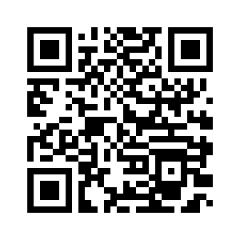
QUESTIONS?
Complete this survey by September 23 and be entered to win a $100 gift card!
15-20 minutes to complete

Slide 20
Membership Registration
Join members online at register.skillsusa.org.
Review instructions in the Chapter Success Guide to activate Member Enroll
Students enter their membership information, advisors submit and agree to invoicing terms
To be eligible for competition:
At least 6 students and 1 professional member
Registered by February 1 (check regional deadlines)
Paid by March 1
$16/student, $35/professional
Affiliation Plans available

Slide 21
Affiliation Plans
Affiliation plans available:
Total Participation Plan (TPP) – MS, HS, CPS/HS combined
College Campus Affiliation Plan – CPS
Available for membership for an entire CTE program, school, schools/programs within a district, and whole school districts
Reduced membership costs for full program/campus affiliation – must join all eligible students
Allows schools to use alternate funding sources
Affiliation fee (sliding scale) + Professional membership
Educational resources credit (TPP only) – $5.95/student
https://www.skillsusa.org/join/how-to-join/

Slide 22
Affiliation Plan Example
225 Students | Traditional Membership | TPP | College Campus
Affiliation Fee | $16/student | $1,312 | $3,360
Educational Resource Credit | N/A | $5.95 x 225 = $1,338.75 | N/A
Total Student Cost | $3,600 | $2,650.75 | $3,360
Professional Affiliation | 1/program | 1 per 100 | 1 per 25
Professional Affiliation Cost | 7 x $35 = $245 | 3 x $35 = $105 | 9 x $35 = $315
Total Cost | $3,845 | $2,755.75 | $3,675
Total Cost per Member | $16/$35 ($16.57, 232) | $12.09 (228) | $15.71 (234)
Educational Resources credit can be used to purchase Career Essentials, Framework support resources, coaching guides for select leadership contests, and a variety of other resources – skillsusastore.net

Slide 23
Required Forms
Chapter Information Form
Contact for Lead Advisor, school admin, and bookkeeper
Required before membership registration, once per program year
https://form.jotform.com/241896486613065
Approved Chaperone Form
List of school-approved chaperones attending overnight SkillsUSA events, and certification they are approved by the school to serve in that capacity
Required before the first overnight activity, once per program year
https://www.skillsusafl.org/wp-content/uploads/2023/08/Chaperone-Certification-and-Volunteer-Screening-Form.pdf
Code of Conduct Form
Separate form for students and advisors to acknowledge behavior expectations for events
Required for each registered attendee at each SkillsUSA activity, and is due at registration

Slide 24
Event Registration – General
Register for events online at register.skillsusa.org
Must be registered members to register for competition
Follow steps in conference guides
Onsite Registration and Packet Pickup
FLC – Monday, October 28, 8 AM to 9 AM
SLSC –Monday, April 28, 2 PM to 6 PM
NLSC – Monday, June 25, 4 PM to 6 PM
Bring required forms and any outstanding payments

Slide 25
Invoicing and Payments
When registering for state events (FLC, SLSC):
Click on Submit Registration and follow prompts.
Invoices for events can be generated by training program or by school.
An invoice will be generated in a pop-up window, and will be emailed to you. Submit this invoice to your purchasing department for processing.
When registering for national events (NLSC):
Submit registration as above.
Complete any hotel rooming lists.
Alert the state office you are ready for an invoice, OR one will be sent after the deadline.
Registration invoices are final after the registration deadline. No drops or refunds after the deadline.

Slide 26
Invoicing and Payments
Payment is due by the published deadline.
Checks and credit cards accepted.
Credit cards – 2.5% administrative fee for transactions
https://square.link/u/D0gKSQZj
Use this link for all events – include invoice number
Follow up with your bookkeeper to ensure payments are processed!
Current W-9 on Advisor Resources page
Use the correct vendor number -
Events: SkillsUSA Florida/ Florida SkillsUSA Inc (Jacksonville)
Membership: SkillsUSA Inc. (Virginia)

Slide 27
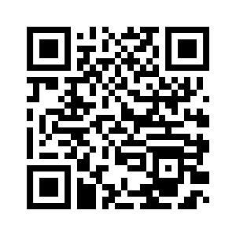
QUESTIONS?
COMPLETE THE
CHAPTER INFORMATION FORM:

Slide 28
Regional Fall Meetings
Check with your Regional Coordinator for dates and locations.
May include:
Regional officer elections
Steering committee/advisor meeting
Student professional development
Other activities

Slide 29
Fall Leadership Conference
October 28-29, 2024
Registration closes September 30
Hilton Melbourne, 200 Rialto Place, Melbourne, FL
State leadership training activity
Essential elements: Teamwork, Planning, Organizing and Management, and Adaptability/Flexibility
Student track: Maximize
Open to chapter leaders and officers, regional officers, and any students looking to grow their chapter and career readiness skills.
Advisor track – Chapter Management Institute (CMI)
Open to advisors of all experience levels with varied programming based on experience.
FLC24 Conference Guide – on Advisor Resources page

Slide 30
Advisor Meeting and Planning Session
October 28, 2024
10 AM to 2 PM, Hilton Melbourne
Lunch is provided, no cost to attend.
General state planning and information
Work by contest or career cluster to provide feedback and guidance for competitions
State Education Team work
Test bank questions, project templates, station templates, etc.
Transition to annual business meeting
Register here: https://form.jotform.com/241844803898167

Slide 31
State Education Team
Educators who are proficient in their trade and knowledgeable in the competition expectations.
Support for Technical Committees in securing equipment, set up and take down, contest facilitation.
Meet with contest committee to provide educational insight – how long tasks should take, educational standard alignment, written test question bank, etc.
Does not have prior knowledge of competition, assist with project creation, or score contestants.
Review the requirements and apply here
Obtain a letter of support from your admin

Slide 32
SLSC25 – General Information
State Leadership and Skills Conference
April 28 – May 1, 2025
Jacksonville, FL
100+ competitions, professional development, CareerExpo, Meet the Employer, Champions’ Festival, and more!
Registration opens: February 1, 2025
Registration closes: March 10, 2025 at 11:59 PM
No drops or refunds after this time.
Hotel reservation deadline: March 17, 2025
Registration payment deadline: March 24, 2025
Credit cards – 2.5% fee
https://square.link/u/D0gKSQZj - include invoice number(s)

Slide 33
SLSC25 – Hotel and Venues
Primary competition venue and hotel – Hyatt Regency Jacksonville Riverfront, 225 East Coastline Drive
Room rate: $190/night
Overflow hotel – Doubletree Jacksonville Riverfront, 1201 Riverplace Blvd
Room rate: TBD
Offsite competition and event venues:
Prime Osborn Convention Center, 1000 Water St
Florida State College at Jacksonville, 101 W State St
Transportation is provided between both hotels and all offsite contest locations.

Slide 34
SLSC25 – Registration Fee Information
Registration Fees
$150 per person, including contestants, advisors, models, and observers.
$50 per person for Courtesy Corps Members.
$35 per day for day passes – Tuesday, Wednesday only
We are exploring ticket options for parents and other supporters at the Closing Ceremony on Thursday. At this time, NO ADMISSION without conference credentials.

Slide 35
SLSC25 – General Agenda
April 28
2 PM – 6 PM: Registration
7 PM – 9 PM: Opening Ceremony
April 29 and 30
8 AM – 4 PM: Competitions, CareerExpo, professional development, community service project, delegate sessions
5 PM – 8 PM: Meet the Employer Career Fair (Tuesday)
6 PM – 10 PM: Champions’ Festival (Wednesday)
May 1
8:30 AM – 11:30 AM: Closing Ceremony
12 PM – 1 PM: NLSC Delegation Meeting – Gold medalists and their advisors attending NLSC

Slide 36
Leadership Opportunities for Students
Branding Design Contest
Courtesy Corps
State Officer Candidates and Delegate Program
Glam Squad
Social Media Ambassadors

Slide 37
NLSC25 – General Information
National Leadership and Skills Conference
June 23-27, 2025
Atlanta, GA
Registration opens: May 1, 2025
Registration closes: May 12, 2025 at 11:59 PM
No drops or refunds after this time.
Hotel reservation deadline: May 12, 2025
Registration payment deadline: May 23, 2025
Credit cards – 2.5% fee
https://square.link/u/D0gKSQZj - include invoice number(s)

Slide 38
NLSC25 – Hotel and Venues
Official state hotel – TBD
Monday State Meeting and Friday Celebration Dinner will be held at the official hotel.
All members of the Florida delegation must book through the state office and stay at the assigned hotel.
Contest Venue – Georgia World Congress Center, 285 Andrew Young International Blvd NW
Limited bus transportation is provided, primarily for folks with mobility issues or large/heavy tools or displays.

Slide 39
NLSC25 – Registration Fee Information
Official Florida Delegation includes contestants, advisors, other individuals whose fees will be paid by the school (i.e., chaperone, model)
Registration Package options include:
5- or 6-nights hotel, including taxes and fees (parking separate)
Conference registration
SkillsUSA Florida swag, including pins and conference shirt
Dinner on Monday and Friday with our state delegation
Champions’ Festival, SkillsUSA University, Opening and Closing Ceremonies, and all other conference activities.
Estimated package costs available in the Chapter Success Guide

Slide 40
NLSC25 – General Agenda
June 23 – State Registration (4 PM) and Dinner, (6 PM)
June 24 – Opening Session, 5 PM
June 24 – 26 – Contests, 8 AM
SkillsUSA University, TECHSPO, Delegate activities, and other conference activities
June 26 – Champions’ Festival, 6 PM
June 27 – Closing and Awards Ceremony, 5 PM, followed by State Celebration Dinner
June 28 – Travel Home

Slide 41
QUESTIONS?

Slide 42
Competition Basics
What is offered at the state level: Contests by Cluster
What is offered at the regional level (except Region 5): Regional Intent to Enter Due by October 15
Planning tool to evaluate which contests will be run at the regional level.
Check with your Regional Coordinator for more info
At the end of regional competitions, advisors will be alerted which students are advancing to state in each contest. Sometimes it may be more or less than the medalists.
Register contestants after your regional event until March 10.
Be mindful of membership – students must be registered members to compete.

Slide 43
How to Prepare for Competitions
Review the contest Technical Standards
Standards and competencies that will be tested
Supply and materials list
Written exam information
Tech Standards are written for national competition
State contest will mirror nationals to the greatest extent possible
Less time, resources, space, materials, etc than NLSC
Review the General Regulations – state and national
Check for contest updates – supply lists, advance information, changes to national standards. Not all contests will have an update.
State – skillsusafl.org/slsc/updates
National – updates.skillsusa.org

Slide 44
Competition Information – Testing
All contests require the Professional Development test.
NEW THIS YEAR: All students must take the PD test. Middle school students will test onsite in person. Special needs contests will use the PDT as a tie-breaker only.
Study guide available in Absorb with Technical Standards.
Most contests require a technical exam.
Exams may be completed online in advance, more info coming soon.
Specific testing window, proctor required.
Testing requirement list available by early November.

Slide 45
Championships Updates
Technical Standards
Available now with professional membership
Now updated every 2 years
Will be available for student access
SkillsUSA Connect – Fall-ish 2024
General Regulations
State – https://www.skillsusafl.org/wp-content/uploads/2024/08/State-General-Regulations-2024-2025.pdf
National – https://skillsusa.egnyte.com/dl/cU5nXh93ER
Contest Guide
Available September 1
Review list of competitions and request changes by December 1!
Contests by Cluster - https://www.skillsusafl.org/wp-content/uploads/2024/08/Contests-by-Cluster-2024-2025.pdf

Slide 46
Championships Updates
Contest Name Changes:
Audio Radio Production – Audio Production
Television (Video) Production – Video Production
NOTE: Video News Production
Contest Status Changes:
FACILITHON
Official contest status – occupationally related
Facilities management
Scenario and emergency situation evaluation and reaction
Offered at the state level since 2017
Residential and Commercial Appliance Technology
Removed from official contest status
New process to evaluate national competition status

Slide 47
Championships Updates
Major Technical Standards Updates:
Safety letter, certification, or similar requirement:
Medical Terminology – 2-hour time limit
Job Interview – Portfolio outline
Robotics and Automation – major changes to standards
Automotive Service
Baking and Pastry Arts
Cabinetmaking
Career Pathways
Carpentry
Commercial Roofing
Culinary Arts
Diesel Equipment Technology
Emergency Medical Technician
First Aid/CPR
Nurse Assisting
Practical Nursing
Teamworks
Video Production
Welding
Welding Fab
Welding Sculpture

Slide 48
Championships Updates
New Competition Clothing:
Debuted at NLSC24 – mannequins and live models
Ariat clothing
Class C – Manufacturing/Construction
Class D – Competition specific (automotive, law and public safety – current light blue short sleeved workshirt)
Class I – Welding
Proposed 3-year rollout for national contests:
2025 – Available for purchase
2026 – Transition year
2027 – new uniforms required at NLSC
State requirements – slower implementation
Cluster t-shirts
Current exceptions in General Regulations

Slide 49
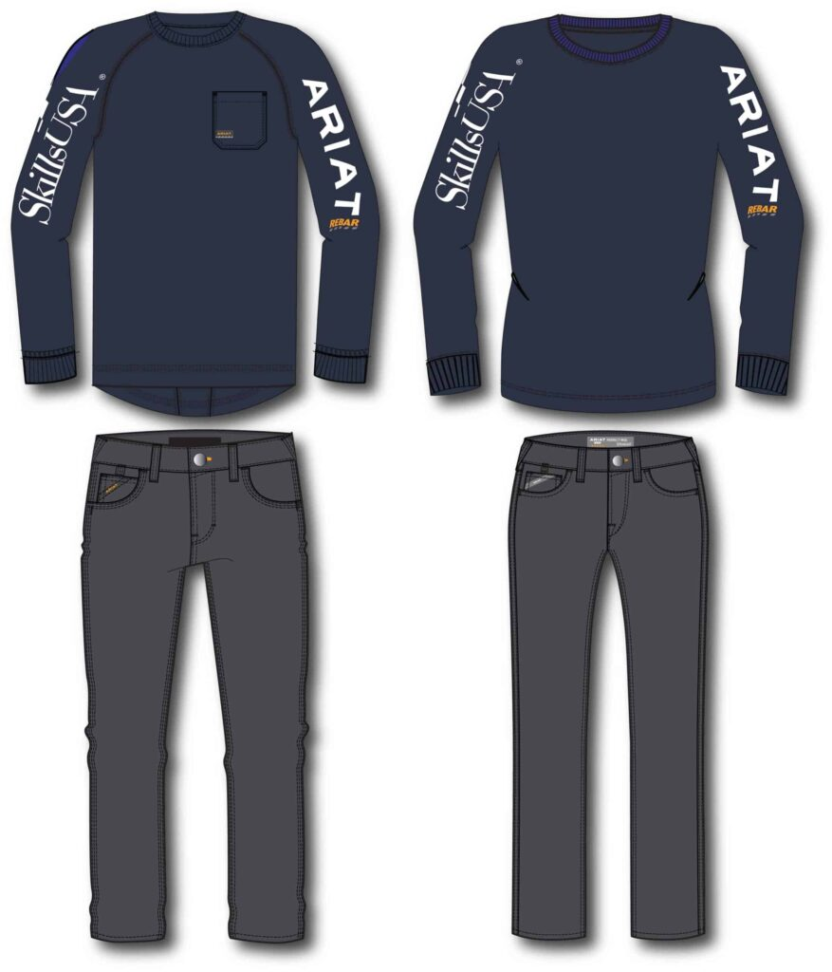
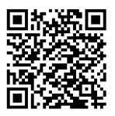
PROVIDE YOUR FEEDBACK TO THE NATIONAL OFFICE:
https://www.skillsusa.org/competition-clothing-from-ariat/

Slide 50
Future SLSC Dates
2025
Monday, April 28 – Thursday, May 1, 2025
Jacksonville, FL
Monday, March 30 – Thursday, April 2, 2026
Jacksonville, FL
2026
Monday, April 26 – Thursday, April 29, 2027
Jacksonville, FL
2027

Slide 51
Jessica Graber jgraber@skillsusafl.org 850-284-8534 Jayde Alioto jaydea@skillsusafl.org 352-322-3345

